Slide 1

A Lightweight Secure Data Sharing Scheme for Mobile Cloud Computing
B.TECH
in
Computer Science and Engineering
By
G. Jagadeesh 18R61A0516
K. Jaswanth Sai 18R61A0518
SK. Fayaz 18R61A0536
Under the guidance of
Mr. A. Ravi M.TECH .,
Associate Professor
PRIYADHARSHINI COLLEGE OF ENGINEERING AND TECHNOLOGY NELLORE

Slide 2
CERTIFICATE
This is to certify that the project report entitled A lightweight secure data sharing scheme for mobile cloud computing submitted by K. Jaswanth sai to the Priyadarshini college of engineering and technology, Nellore in partial fulfillment of for the award of the degree of B.Tech in CSE is a bona fide record of project work carried out by him under our supervisor. The contents of this report, in full or in parts, have not been submitted to any other institution or university for the award of any degree or diploma.
signature signature
name of the supervisor name of the co-supervisor
supervisor co-supervisor
Department of CSE Department of CSE
counter signature of HOD with seal
<month,year>
Submitted for viva voce held on __________________

Slide 3
DECLARATION
I declare that this project report titled A light weight secure date sharing scheme for mobile cloud computing submitted in partial fulfillment of the degree of B.Tech in CSE is a record of original work carried out by me under the supervision of <Name(s) of the Supervisor(s)>, and has not formed the basis for the award of any other degree or diploma, in this or any other Institution or University. In keeping with the ethical practice in reporting scientific information, due acknowledgements have been made wherever the findings of others have been cited.
<signature>
k. Jaswanth sai
18R61A0518

Slide 4
ACKNOWLEDGMENTS
The satisfaction and elation that accompany the successful completion of any task would be incomplete without the mention of the people who have made it a possibility. It is my great privilege to express my gratitude and respect to all those who have guided me and inspired me during the course of this project work.
First and foremost, I express my sincere gratitude to our honorable chairman. Sri P V Sreenatha Reddy Garu who provided all facilities and necessary encouragement during the course of study.
I extend my gratitude and sincere thanks to our beloved principal sri.UV.Raja Yadavgaru, for providing necessary infrastructure and permitting me to complete the project.
I extend my gratitude and sincere thanks to our beloved principal Dr.M.Maruthi Prasada Reddy, for motivating and providing necessary infrastructure and permitting me to complete the project.
I would like to express the sense of gratitude towards our Head of the Department _____________________ my internal guide_____________________ for their support and encouragement for completion of this project.
Finally, I express my sincere thanks to all the teaching and non-teaching staff that guided and helped me to complete the project work successfully.
I extend my sincere thanks to one and all of priyadarshini family for the completion of this document on the project report format guidelines.
K. Jaswanth sai
18R61A0518

Slide 5
ABSTRACT
With the popularity of cloud computing, mobile devices can store/retrieve personal data from anywhere at any time.
Consequently, the data security problem in mobile cloud becomes more and more severe and prevents further development of mobile cloud.
There are substantial studies that have been conducted to improve the cloud security. However, most of them are not applicable for mobile cloud since mobile devices only have limited computing resources and power.
Solutions with low computational overhead are in great need for mobile cloud applications. In this paper, we propose a lightweight data sharing scheme (LDSS) for mobile cloud computing.
It adopts CP-ABE, an access control technology used in normal cloud environment, but changes the structure of access control tree to make it suitable for mobile cloud environments.
LDSS moves a large portion of the computational intensive access control tree transformation in CP-ABE from mobile devices to external proxy servers. Furthermore, to reduce the user revocation cost, it introduces attribute description fields to implement lazy-revocation, which is a thorny issue in program based CP-ABE systems.
The experimental results show that LDSS can effectively reduce the overhead on the mobile device side when users are sharing data in mobile cloud environments.

Slide 6
EXISTING SYSTEM
With the development of cloud computing and the popularity of smart mobile devices, people are gradually getting accustomed to a new era of data sharing model in which the data is stored on the cloud and the mobile devices are used to store/retrieve the data from the cloud. Typically, mobile devices only have limited storage space and computing power.
On the contrary, the cloud has enormous amount of resources. In such a scenario, to achieve the satisfactory performance, it is essential to use the resources provided by the cloud service provider to store and share the data.
the development of cloud computing and the popularity of smart mobile devices, people are gradually getting accustomed to a new era of data sharing model in which the data is stored on the cloud and the mobile devices are used to store/retrieve the data from the cloud. Typically, mobile
devices only have limited storage space and computing power. On the contrary, the cloud has enormous amount of resources. In such a scenario, to achieve the satisfactory performance, it is essential to use the resources provided by the cloud service provider to store and share the data
Limitations:
There is no proper mechanism for providing the security for data that is presented in the mobile cloud.
user authentication and revocation cost will be high.

Slide 7
PROPOSED SYSTEM
Apparently, to solve the above problems, personal sensitive data should be encrypted before uploaded onto the cloud. so that the data is secure against the CSP
However, the data encryption brings new problems. How to provide efficient access control mechanism on cipher text decryption so that only the authorized users can access the plaintext data is challenging.
In addition, system must offer data owners effective user privilege management capability, so they can grant/revoke data access privileges easily on the data users.
There have been substantial researches on the issue of data access control over cipher text. In these researches, they have the following common assumptions.
First, the CSP is considered honest and curious. Second, all the sensitive data are encrypted before uploaded to the Cloud. Third, user authorization on certain data is achieved through encryption/decryption key distribution.
In general, we can divide these approaches into four categories: simple cipher text access control, hierarchical access control, access control based on fully homomorphic encryption and access control based on attribute-based encryption (ABE). Allthese proposals are designed for non-mobile cloud environment.
Advantages:
We are providing methods for efficient access of the data.
Performance has been increased with the reduced cost.

Slide 8
TABLE OF CONTENT
DESCRIPTION | PAGE NUMBER
CERTIFICATE | 2
DECLARATION | 3
ACKNOWLEDGMENTS | 4
ABSTRACT | 5-7
LIST OF FIGURES | 10-14
LIST OF TABLES | 15-19
ABBREVATIONS/NOTATIONS/NOMENCLATURE | 20
1 . CHAPTER 1
1.1 INTRODUCTION
1.2 CLOUD COMPUTING | 21-27
2 . CHAPTER 2
2.1 LITERATURE SURVEY | 28-32
3. CHAPTER 3
3.1 PROCEDURE | 33
4. CHAPTER 4

Slide 9
4.1 RESULT ANALYSIS | 34
5. CHAPTER 5
5.1 SUMMARY AND CONCLUSION | 35
REFERENCES | 36

Slide 10
LIST OF FIGURES
FIGURE | TITLE | PAGE NUMBER
1.1 | SEMI TRUSTED SERVER | 11
1.2 | ACCESS CONTROL TREE | 12
1.3 | KEY GENERATION | 13
1.4 | A SAMPLE ATTRIBUTE DESCRIPTION FIELD OF DATA USER | 14

Slide 11
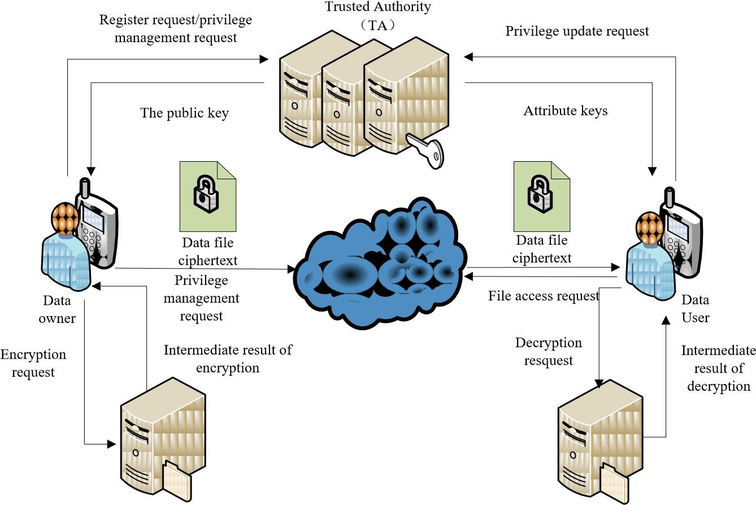
SEMI TRUSTED SERVER

Slide 12
ACCESS CONTROL TREE
OR
AND
AND
peers
relatives
AND
intimatcy>1
Friends
HuBei

Slide 13
KEY GENERATION
Ta
AND
Tv
OR
Av
AND
AND
peers
relatives
AND
intimatcy>1
Friends
HuBei

Slide 14
A sample attribute description field of data user
1
0
1
1
0
K1
K2
K3
Attribute
Attribute
Description
Keys

Slide 15
LIST OF TABLES
TABLE | TITLE | PAGE NUMBER
1 | COMPUTATIONAL OVERHEAD OF BASIC OPERATIONS OF ABE SCHEMES | 16
2 | COMPUTATIONAL OVERHEAD OF DATA SHARING | 17
3 | COMPUTATIONAL OVERHEAD OF DATA ACCESS | 18
4 | COMPUTATIONAL OVERHEAD WITH DIFFERENT CP-ABES | 19

Slide 16
TABLE-1 :COMPUTATIONAL OVERHEAD OF BASIC OPERATIONS OF ABE SCHEMES
Types of Devices | Pairing | Exponentiation | Multiplication
PC | 20 ms | 5 ms | 0.7 ms
Mobile | 550 ms | 177 ms | 26 ms

Slide 17
TABLE-2 :COMPUTATIONAL OVERHEAD OF DATA SHARING
 | Exponentiation on G0 | Exponentiation on G1 | Paring on G0
ESP | 2|Ta| | 0 | 0
DO | 3 | 1 | 0

Slide 18
TABLE-3 :COMPUTATIONAL OVERHEAD OF DATA ACCESS
 | Exponentiation on G0 | Exponentiation on G1 | Paring on G0
DSP | 0 | |Ta| | 2|Ta|+1
DO | 0 | 1 | 0

Slide 19
TABLE-4 :COMPUTATIONAL OVERHEAD WITH DIFFERENT CP-ABES
 | Bethencourt | BSW CP-ABE | LDSS
Data sharing | (2|Ta|+1)T_ G0+T_G1 | (4|Ta|+1)T_ G0+T_G1 | 3T_G0+T_Gm
Data access | (2|Au|+1)T_Ge | (2|Au|+1)T_Ge | T_G0+T_Gm

Slide 20
ABBREVATION/NOTATION/NOMENCLATURE

Slide 21
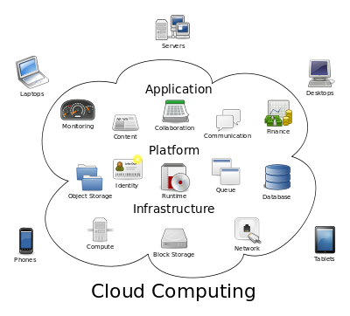
CHAPTER-1 INTRODUCTION
CLOUD COMPUTING
Cloud computing is the use of computing resources (hardware and software) that are delivered as a service over a network (typically the Internet). The name comes from the common use of a cloud-shaped symbol as an abstraction for the complex infrastructure it contains in system diagrams. Cloud computing entrusts remote services with a user's data, software and computation. Cloud computing consists of hardware and software resources made available on the Internet as managed third-party services. These services typically provide access to advanced software applications and high-end networks of server computers
STRUCTURE OF CLOUD COMPUTING

Slide 22
How Cloud Computing Works?
The goal of cloud computing is to apply traditional supercomputing, or high-performance computing power, normally used by military and research facilities, to perform tens of trillions of computations per second, in consumer-oriented applications such as financial portfolios, to deliver personalized information, to provide data storage or to power large, immersive computer games.
The cloud computing uses networks of large groups of servers typically running low-cost consumer PC technology with specialized connections to spread data-processing chores across them. This shared IT infrastructure contains large pools of systems that are linked together. Often, virtualization techniques are used to maximize the power of cloud computing.

Slide 23
Characteristics and Services Models:
The salient characteristics of cloud computing based on the definitions provided by the National Institute of Standards and Terminology (NIST) are outlined below:
On-demand self-service: A consumer can unilaterally provision computing capabilities, such as server time and network storage, as needed automatically without requiring human interaction with each service’s provider.
Broad network access: Capabilities are available over the network and accessed through standard mechanisms that promote use by heterogeneous thin or thick client platforms (e.g., mobile phones, laptops, and PDAs).
Resource pooling: The provider’s computing resources are pooled to serve multiple consumers using a multi-tenant model, with different physical and virtual resources dynamically assigned and reassigned according to consumer demand. There is a sense of location-independence in that the customer generally has no control or knowledge over the exact location of the provided resources but may be able to specify location at a higher level of abstraction (e.g., country, state, or data center). Examples of resources include storage, processing, memory, network bandwidth, and virtual machines.

Slide 24
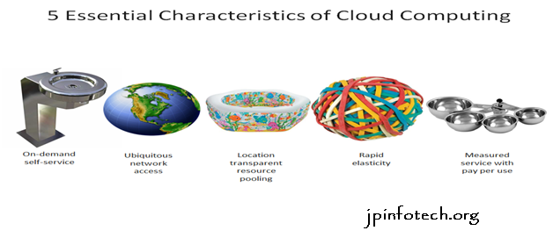
Rapid elasticity: Capabilities can be rapidly and elastically provisioned, in some cases automatically, to quickly scale out and rapidly released to quickly scale in. To the consumer, the capabilities available for provisioning often appear to be unlimited and can be purchased in any quantity at any time.
Measured service: Cloud systems automatically control and optimize resource use by leveraging a metering capability at some level of abstraction appropriate to the type of service (e.g., storage, processing, bandwidth, and active user accounts). Resource usage can be managed, controlled, and reported providing transparency for both the provider and consumer of the utilized service.
CHARACTERISTICS OF CLOUD COMPUTING

Slide 25
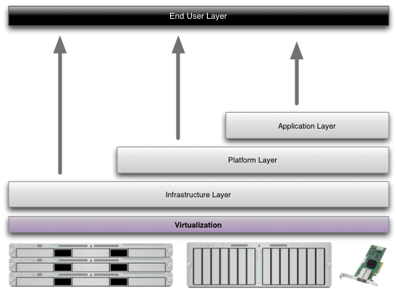
Services Models:
Cloud Computing comprises three different service models, namely Infrastructure-as-a-Service (IaaS), Platform-as-a-Service (PaaS), and Software-as-a-Service (SaaS). The three service models or layer are completed by an end user layer that encapsulates the end user perspective on cloud services. The model is shown in figure below. If a cloud user accesses services on the infrastructure layer, for instance, she can run her own applications on the resources of a cloud infrastructure and remain responsible for the support, maintenance, and security of these applications herself. If she accesses a service on the application layer, these tasks are normally taken care of by the cloud service provider.
STRUCTURE OF SERVICE MODELS

Slide 26
Benefits of cloud computing:
Achieve economies of scale – increase volume output or productivity with fewer people. Your cost per unit, project or product plummets.
Reduce spending on technology infrastructure. Maintain easy access to your information with minimal upfront spending. Pay as you go (weekly, quarterly or yearly), based on demand.
Globalize your workforce on the cheap. People worldwide can access the cloud, provided they have an Internet connection.
Streamline processes. Get more work done in less time with less people.
Reduce capital costs. There’s no need to spend big money on hardware, software or licensing fees.
Improve accessibility. You have access anytime, anywhere, making your life so much easier!
Monitor projects more effectively. Stay within budget and ahead of completion cycle times.
Less personnel training is needed. It takes fewer people to do more work on a cloud, with a minimal learning curve on hardware and software issues.
Minimize licensing new software. Stretch and grow without the need to buy expensive software licenses or programs.
Improve flexibility. You can change direction without serious “people” or “financial” issues at stake.

Slide 27
Advantages:
Price: Pay for only the resources used.
Security: Cloud instances are isolated in the network from other instances for improved security.
Performance: Instances can be added instantly for improved performance. Clients have access to the total resources of the Cloud’s core hardware.
Scalability: Auto-deploy cloud instances when needed.
Uptime: Uses multiple servers for maximum redundancies. In case of server failure, instances can be automatically created on another server.
Control: Able to login from any location. Server snapshot and a software library lets you deploy custom instances.
Traffic: Deals with spike in traffic with quick deployment of additional instances to handle the load.

Slide 28
CHAPTER-2 LITERATURE SURVEY
Attribute-based fine-grained access control with efficient revocation in cloud storage systems
AUTHORS: Kan Yang, Xiaohua Jia, Kui Ren
A cloud storage service allows data owner to outsource their data to the cloud and through which provide the data access to the users. Because the cloud server and the data owner are not in the same trust domain, the semi-trusted cloud server cannot be relied to enforce the access policy. To address this challenge, traditional methods usually require the data owner to encrypt the data and deliver decryption keys to authorized users. These methods, however, normally involve complicated key management and high overhead on data owner. In this paper, we design an access control framework for cloud storage systems that achieves fine-grained access control based on an adapted Ciphertext-Policy Attribute-based Encryption (CP-ABE) approach. In the proposed scheme, an efficient attribute revocation method is proposed to cope with the dynamic changes of users' access privileges in large-scale systems. The analysis shows that the proposed access control scheme is provably secure in the random oracle model and efficient to be applied into practice.

Slide 29
2) Achieving Usable and Privacy-assured Similarity Search over Outsourced Cloud Data
AUTHORS: Cong Wang, Kui Ren, Shucheng Yu, and Karthik Mahendra Raje
As the data produced by individuals and enterprises that need to be stored and utilized are rapidly increasing, data owners are motivated to outsource their local complex data management systems into the cloud for its great flexibility and economic savings. However, as sensitive cloud data may have to be encrypted before outsourcing, which obsoletes the traditional data utilization service based on plaintext keyword search, how to enable privacy-assured utilization mechanisms for outsourced cloud data is thus of paramount importance. Considering the large number of on-demand data users and huge amount of outsourced data files in cloud, the problem is particularly challenging, as it is extremely difficult to meet also the practical requirements of performance, system usability, and high-level user searching experiences. In this paper, we investigate the problem of secure and efficient similarity search over outsourced cloud data. Similarity search is a fundamental and powerful tool widely used in plaintext information retrieval, but has not been quite explored in the encrypted data domain. Our mechanism design first exploits a suppressing technique to build storage-efficient similarity keyword set from a given document collection, with edit distance as the similarity metric.
Based on that, we then build a private trie-traverse searching index, and show it correctly achieves the defined similarity search functionality with constant search time complexity. We formally prove the privacy-preserving guarantee of the proposed mechanism under rigorous security treatment. To demonstrate the generality of our mechanism and further enrich the application spectrum, we also show our new construction naturally supports fuzzy search, a previously studied notion aiming only to tolerate typos and representation inconsistencies in the user searching input. The extensive experiments on Amazon cloud platform with real data set further demonstrate the validity and practicality of the proposed mechanism.

Slide 30
DACMACS: Effective Data Access Control for Multiauthority Cloud Storage Systems
AUTHORS: Kan Yang, Xiaohua Jia, Kui Ren, Bo Zhang, Ruitao Xie
Data access control is an effective way to ensure data security in the cloud. However, due to data outsourcing and untrusted cloud servers, the data access control becomes a challenging issue in cloud storage systems. Existing access control schemes are no longer applicable to cloud storage systems, because they either produce multiple encrypted copies of the same data or require a fully trusted cloud server. Ciphertext-policy attribute-based encryption (CP-ABE) is a promising technique for access control of encrypted data. However, due to the inefficiency of decryption and revocation, existing CP-ABE schemes cannot be directly applied to construct a data access control scheme for multiauthority cloud storage systems, where users may hold attributes from multiple authorities. In this paper, we propose data access control for multiauthority cloud storage (DAC-MACS), an effective and secure data access control scheme with efficient decryption and revocation. Specifically, we construct a new multiauthority CP-ABE scheme with efficient decryption, and also design an efficient attribute revocation method that can achieve both forward security and backward security. We further propose an extensive data access control scheme (EDAC-MACS), which is secure under weaker security assumptions.

Slide 31
4) Attribute based proxy re-encryption with delegating capabilities.
AUTHORS: Liang Xiaohui, Cao Zhenfu, Lin Huang
Attribute based proxy re-encryption scheme (ABPRE) is a new cryptographic primitive which extends the traditional proxy re-encryption (public key or identity based cryptosystem) to the attribute based counterpart, and thus empower users with delegating capability in the access control environment. Users, identified by attributes, could freely designate a proxy who can re-encrypt a ciphertext related with a certain access policy to another one with a different access policy. The proposed scheme is proved selective-structure chosen plaintext secure and master key secure without random oracles. Besides, we develop another kind of key delegating capability in our scheme and also discuss some related issues including a stronger security model and applications.

Slide 32
5) Attribute based proxy re-encryption with delegating capabilities
AUTHORS: Liang Xiaohui, Cao Zhenfu, Lin Huang
Attribute based proxy re-encryption scheme (ABPRE) is a new cryptographic primitive which extends the traditional proxy re-encryption (public key or identity based cryptosystem) to the attribute based counterpart, and thus empower users with delegating capability in the access control environment. Users, identified by attributes, could freely designate a proxy who can re-encrypt a ciphertext related with a certain access policy to another one with a different access policy. The proposed scheme is proved selective-structure chosen plaintext secure and master key secure without random oracles. Besides, we develop another kind of key delegating capability in our scheme and also discuss some related issues including a stronger security model and applications.

Slide 33
CHAPTER-3 PROCEDURE
Attribute-based encryption (ABE) is proposed by Sahai and Waters [29].
It is derived from the Identity-Based Encryption (IBE) and is particularly suitable for one-tomany data sharing scenarios in a distributed and open cloud environment. Attribute-based encryption is divided into two categories: one is the Ciphertext-Policy Attribute Based Encryption (CP-ABE), in which the access control policy is embedded into ciphertext; the other one is KeyPolicy Attribute Based Encryption (KP-ABE), in which the access control policy is embedded in the user's key attributes.
In real applications, CP-ABE is more suitable since it resembles role-based access control. In CP-ABE, the data owner designs the access control policy and assigns attributes to data users. A user can decrypt the data properly if the user’s attributes satisfy the access control policy.
1 Encryption(K, PK, T): Generate the ciphertext CT based on the symmetric key K, public key PK and access control tree T .
Decryption(CT,T,SKu): Decrypt the ciphertext CT using the access control tree T and the attribute keys SKu .
We explain all of these functions specifically below.

Slide 34
2 Secret Sharing Scheme
Shamir secret sharing scheme [30] is used to protect secret information. It can be explained as below.
Assume that p is a prime number, the secret information to share is k K  Z _{p} . Divide k into n pieces through the following steps:
(1) Randomly select one (t-1)-order polynomial h x a x( )  _{t1} ^{t1}  ... a x a₁  ₀ Z x_{p}[ ] , and let a₀ k . (2) Select n non-zero and distinct elements Xi from Zp, calculate y_{i}  h x( _{i} ),1 i n.
(3) Distribute y_{i} (1 i n) as shares and publish the corresponding x x₁ ₂, ,...,x_{n} .
The process to reconstruct h(x) out of t random shares through the Lagrange polynomial interpolation is as follows:
t t
h x( ) y_{is} (x x _{ij} ) / (x_{is} x_{ij} )
s1 j1
j s
All these operations are done on Zp, namely, they are all p-mode operations.
After obtaining h(x), we can get the secret k  a₀  h(0):
t t xij

Slide 35
3 OUR PROPOSED MECHANISM
In this section, we describe the LDSS system design. First, we give the overview of LDSS, and then we present LDSS-CP-ABE algorithm and system operations, which are the base of LDSS algorithm. Finally, we describe LDSS in details.
3.1 Overview
We propose LDSS, a framework of lightweight datasharing scheme in mobile cloud (see Fig. 1). It has the following six components.
Data Owner (DO): DO uploads data to the mobile cloud and share it with friends. DO determines the access control policies.
Data User (DU): DU retrieves data from the mobile cloud.
Trust Authority (TA): TA is responsible for generating and distributing attribute keys.
Encryption Service Provider (ESP): ESP provides data encryption operations for DO

Slide 36
CHAPTER-4 RESULT ANALYSIS

Slide 37
CHAPTER-5 SUMMARY AND CONCLUSION
In recent years, many studies on access control in cloud are based on attribute-based encryption algorithm (ABE). However, traditional ABE is not suitable for mobile cloud because it is computationally intensive and mobile devices only have limited resources.
In this paper, we propose LDSS to address this issue. It introduces a novel LDSS-CP-ABE algorithm to migrate major computation overhead from mobile devices onto proxy servers, thus it can solve the secure data sharing problem in mobile cloud.
The experimental results show that LDSS can ensure data privacy in mobile cloud and reduce the overhead on users’ side in mobile cloud.
In the future work, we will design new approaches to ensure data integrity.
To further tap the potential of mobile cloud, we will also study how to do ciphertext retrieval over existing data sharing schemes.

Slide 38
REFERENCES
[1] Gentry C, Halevi S. Implementing gentry’s fully-homomorphic encryption scheme. in: Advances in Cryptology–EUROCRYPT 2011. Berlin, Heidelberg: Springer press, pp. 129-148, 2011.
[2] Brakerski Z, Vaikuntanathan V. Efficient fully homomorphic encryption from (standard) LWE. in: Proceeding of IEEE Symposium on Foundations of Computer Science. California, USA: IEEE press, pp. 97-106, Oct. 2011.
[3] Qihua Wang, Hongxia Jin. "Data leakage mitigation for discertionary access control in collaboration clouds". the 16th ACM Symposium on Access Control Models and Technologies (SACMAT), pp.103-122, Jun. 2011.
[4] Adam Skillen and Mohammad Mannan. On Implementing Deniable Storage Encryption for Mobile Devices. the 20th Annual Network and Distributed System Security Symposium (NDSS), Feb. 2013.
[5] Wang W, Li Z, Owens R, et al. Secure and efficient access to outsourced data. in: Proceedings of the 2009 ACM workshop on Cloud computing security. Chicago, USA: ACM pp. 55-66, 2009.
[6] Maheshwari U, Vingralek R, Shapiro W. How to build a trusted database system on untrusted storage. in: Proceedings of the 4th conference on Symposium on Operating System Design & Implementation-Volume 4. USENIX Association, pp. 10-12, 2000.
[7] Kan Yang, Xiaohua Jia, Kui Ren: Attribute-based fine-grained access control with efficient revocation in cloud storage systems. ASIACCS 2013, pp. 523-528, 2013.
[8] Crampton J, Martin K, Wild P. On key assignment for hierarchical access control. in: Computer Security Foundations Workshop. IEEE press, pp. 14-111, 2006.

Slide 39
THANK YOU

